Slide 1
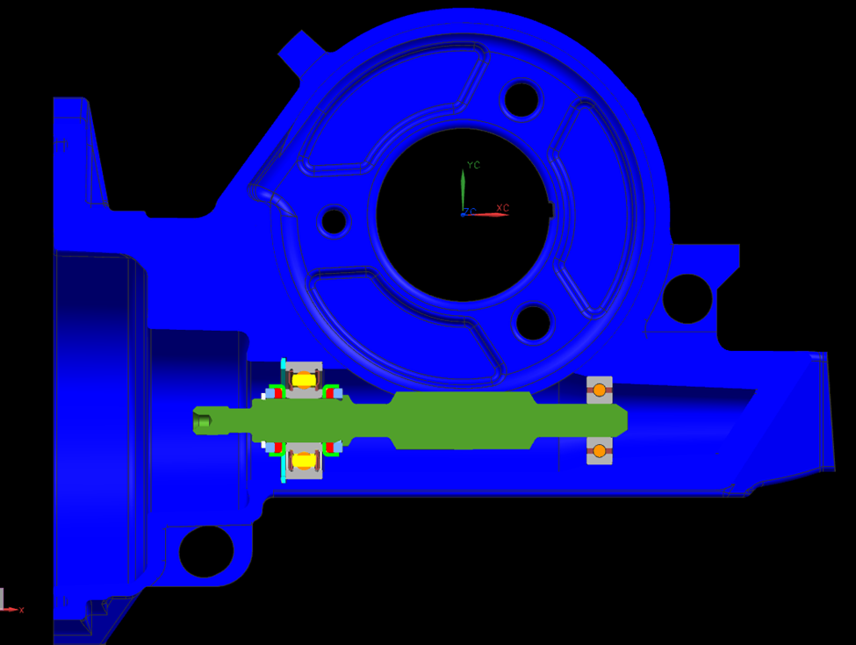
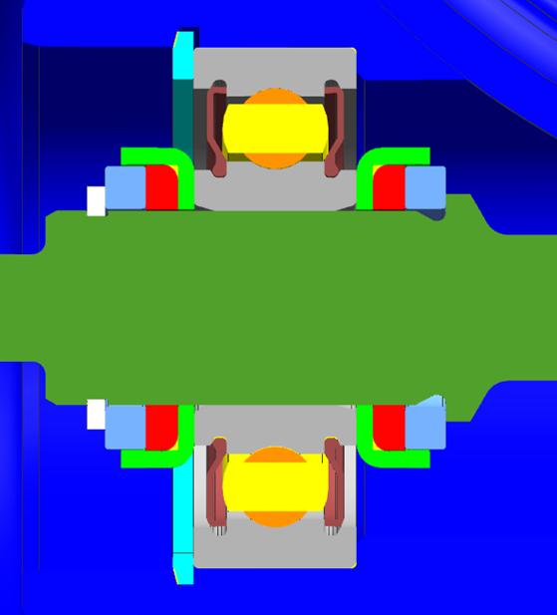
CCM-129: Stiffer Assist Path for Worm Shaft
Last updated: 13AP16
Description
Develop single isolated bearing worm axis design
Motivation : 14.0
Deliverables
Find appropriate worm axis bearing configuration
Coordinate BMPV demos
Find rattle threshold (friction)
Timing
ASAP
Team Members/Customers
Team names: Brad Sundholm
Customers: Application Teams

Slide 2
CCM-129: Stiffer Assist Path for Worm Shaft
Last updated: 13AP16
Status Update:
Assist Mech Bottoming Testing
Damped vs Fixed vs SIB Worm Axis
100Nm VSS test profile
Track backdrive vs cycles and gear failure
PSA BMPV Demo
System being built as a proof of concept for the PSA CMP program
Two different SIB configurations and a fixed worm will be built
Increased Worm Travel SIB
SIB high travel isolators (+/- 0.50mm)
Gamma SIB Demo
Use for tuning and rattle threshold testing
Challenges:
Determining best configuration for worm axis bearings
Getting and modifying parts for BMPV demo
Next Actions:
Find proper worm axis bearing configuration to reduce rattle yet keep friction low
Obtain BMPV components / systems for modification and demo build
Build Gamma demo

